Slide 1

Geolocation Feature
Competitive Analysis and Recommendations
Chris Logan
clogan@governmentcio.com
VSA Facilities Team
December 30, 2020
GitHub Research Folder

Slide 2
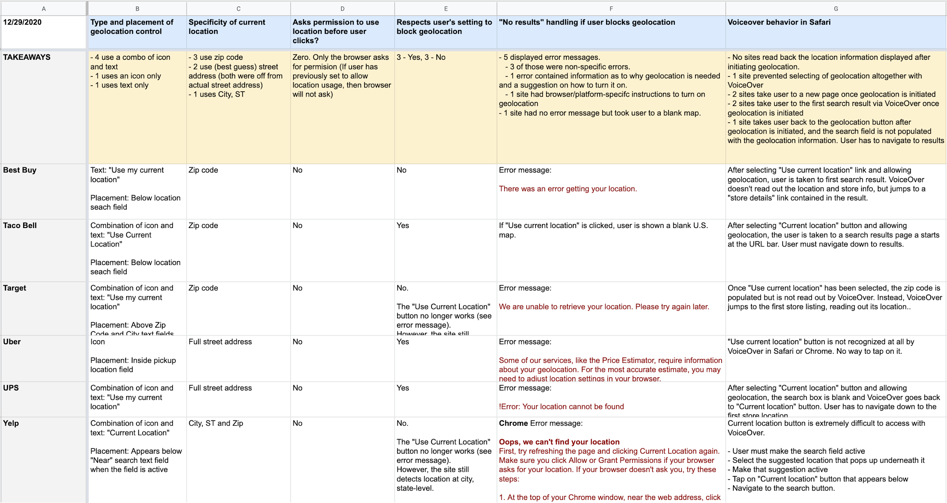
Comparative Example Sites
Geolocation Feature - Competitive Analysis and Recommendations
Google Sheet | PDF
Websites analyzed cover a broad swath of services.
Best Buy
Target
Taco Bell
Uber
UPS
Yelp

Slide 3
Type and Placement of Controls
Geolocation Feature - Competitive Analysis and Recommendations
4 sites use a combination of an icon and text (4 out of 6)
2 sites position control below the search field
2 sites position control above the search field
One site uses text only
Control is positioned below the search field
One site an icon only
Icon is placed within the search field
Recommendations:
Use a combination of icon and text to represent the control.
Position the control to the right of the location text field on desktop, and below the location text field in mobile.

Slide 4
Specificity of Current Location Readout
Geolocation Feature - Competitive Analysis and Recommendations
3 sites display Zip Code
2 sites display their best guess at street address (both were off)
One site uses City, ST
Recommendations:
Display Zip Code as the readout for current location. Street level is not always accurate, and City, ST is not always specific enough to find the nearest location.

Slide 5
Asking Permission to Use Location
Geolocation Feature - Competitive Analysis and Recommendations
If a browser is set to ask for permission, websites ask for permission via a prompt.
Some sites ask before the page is fully loaded, while other sites do not ask for permission until the user initiates the location feature.
Recommendations:
The browser prompt on its own might be unexpected, especially if it displays before the user has taken any action on a page. Given the sensitivity of some Veterans to being tracked:
Avoid the prompt for permission until the user has initiated the location feature.
Include language to accompany the location control that anticipates sensitivity to being tracked. Bring Content in to help craft.

Slide 6
Respecting a User’s Choice to Block Geolocation
Geolocation Feature - Competitive Analysis and Recommendations
3 sites respected the choice to block geolocation by the user. There was no attempt at locating the user, and the location control did not work (see error messaging for this on the next slide).
3 sites did not respect the user’s choice. Although the location control was disabled and displayed an error, the websites used other means to estimate the user’s location and then display nearby store locations.
Recommendations:
Without exception, respect the user’s choice to block geolocation (VA.gov Facility Locator already does this 👍). Workarounds are disrespectful and can engender mistrust, especially for users already sensitive to being tracked. For the behavior of the location control under this scenario, see next slide.

Slide 7
If Geolocation is Blocked
Geolocation Feature - Competitive Analysis and Recommendations
If a user has blocked geolocation, and attempts to initiate the location control, most websites responded with an error.
5 websites displayed an error message.
3 websites displayed errors that were non-specific (eg., “Error getting location”)
One website displayed a more specific error, with information as to why geolocation is needed, and a suggestion on how it might be turned on.
One website contained error messaging with browser and platform-specific instructions on how to turn on geolocation.
One website displayed no error message but took the user to a blank U.S. map.
Recommendations:
Create informative messaging to explain why the control is not working as expected.
Include suggestions on how to turn on geolocation, and consider browser/platform specific instructions.
Bring in Content to help craft the messaging to ensure the language and tone are appropriate.

Slide 8
VoiceOver Behavior
Geolocation Feature - Competitive Analysis and Recommendations
This is an overview of how the 6 websites behaved using VoiceOver to navigate the controls and read back content.
No sites read back the location information that was displayed after initiating geolocation.
One website prevents selecting of geolocation altogether with VoiceOver. The icon was visible but not selectable.
2 websites take the user to a new page once geolocation is initiated.
2 websites take the user to the first search result once geolocation is initiated.
1 website takes the user back to the geolocation button after geolocation is initiated, and the user has to navigate to the search results. The location field is left blank.
Recommendations:
Post submission, the user should hear the amount of results, the query used, and confirmation that their location was referenced e.g., "Showing 10 results for [address] determined by your location." The user’s next readback should be the first result in the list.

